Slide 1
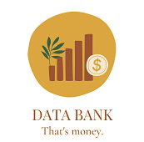
Data Bank – A New Era in Banking
Innovation – Each client is provided with cloud storage linked to their account balance.
Reliability – A distributed network of 5 unique nodes operates across Africa, America, Asia, Australia, and Europe, ensuring seamless performance worldwide.
Scale – Services are available in all regions worldwide, covering thousands of clients.

Slide 2
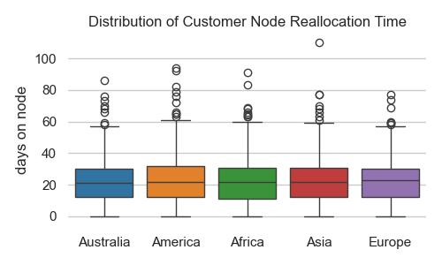
Data Bank – Unique Security Model
Customer data is constantly transferred between nodes, making its protection impenetrable.
On average, customers are reassigned
to a new node every 23 days.

Slide 3
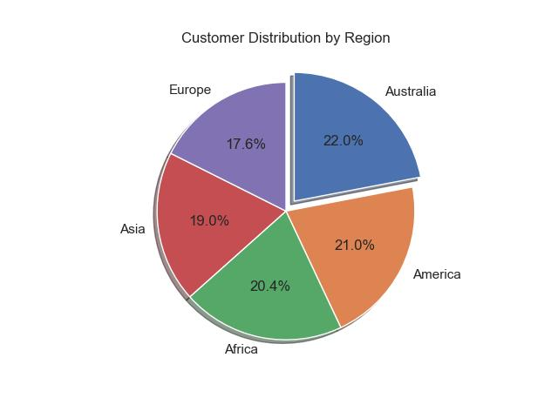
Data Bank – Balanced and Scalable Network
The global distribution of customers ensures balanced system performance and prevents regional overload.
Such a system maintains efficient resource allocation across all regions.

Slide 4
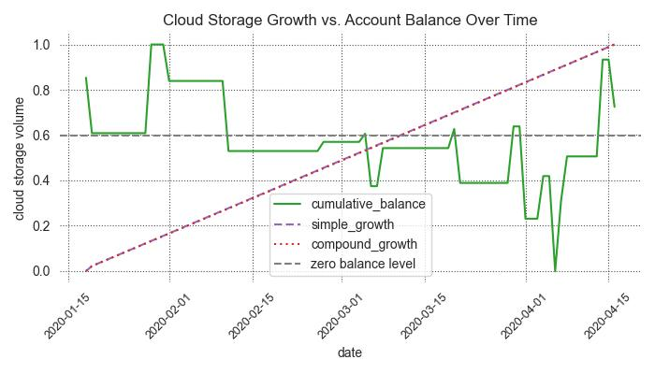
Data Bank – The Future of Finance and Data
100 GB of Secure Cloud Storage for Every Client
Start with a reliable 100 GB of cloud storage upon opening an account. Your storage grows daily at an annual rate of 6%, ensuring a steady increase over time. Even if your balance drops below zero, your data remains safe and accessible—because at Data Bank, security and continuity come first!

